Slide 1

Going Green in Garden City
veganism in the Singapore

Slide 2
Business Problem
Singapore was named the second most vegan-friendly city in Asia by PETA and
sixth most vegan-friendly city in the world by HappyCow.
Given a growing vegan movement in Singapore, where should new vegan food entrepreneurs
consider opening their new municipalities?

Slide 3
Solving the Problem
1. Determine if there is a relationship between population density and number of vegans
restaurants available in the area
2. If there is an association, find out which areas are lacking in vegan restaurants which
could serve as potential areas for entrepreneurs to open new vegan restaurants

Slide 4
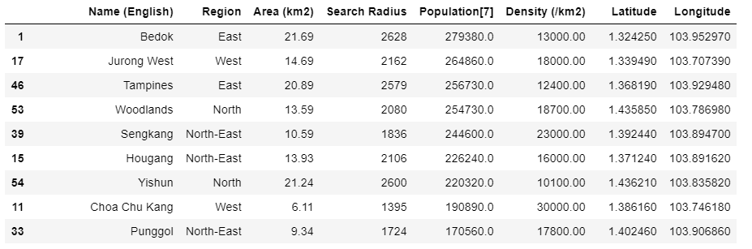
Top 10 Most Populated Areas

Slide 5
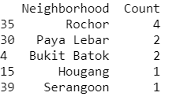
Top 5 Areas with Vegan Restaurants

Slide 6
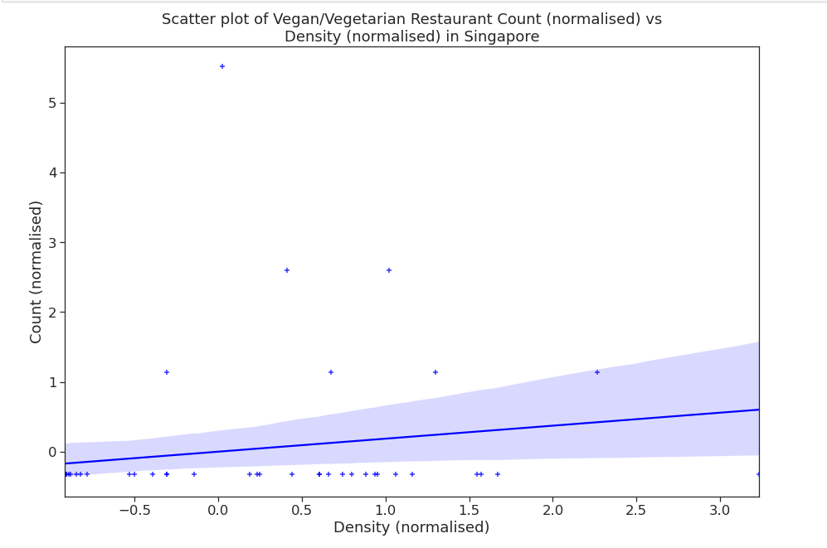
Correlation between Population Density and Number of Vegan Restaurants
There is a positive but weak relationship between the population density of the neighborhood in Singapore and the number of vegan restaurants.

Slide 7
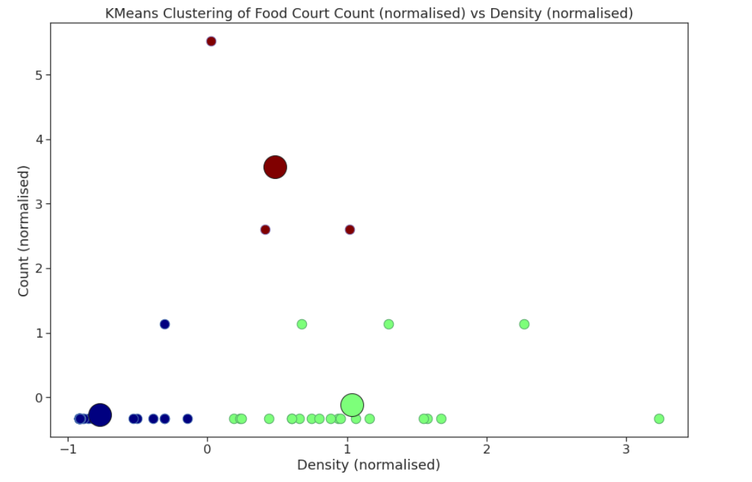
K-Means Clustering based on Density

Slide 8
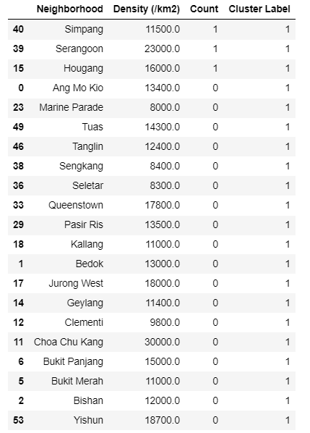
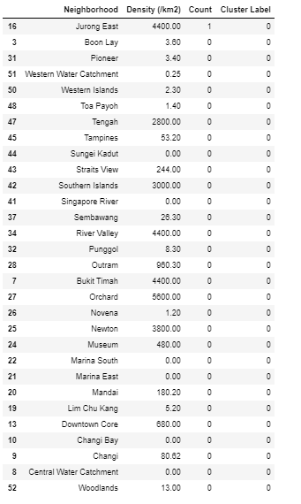
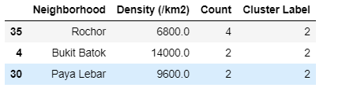
Number of Vegan/Vegetarian Restaurants per cluster

Slide 9
Discussions
The accuracy of the K means algorithm is sufficiently high given the frequency of overlapping density between cluster 1 and 2. However, based on our observations we observe that majority of vegan/vegetarian restaurants are present in cluster 2, with the highest count being in Rocher. While there is a need for more data to safely conclude that opening a vegan restaurant is advisable for a vegan restaurant entrepreneur given the weak correlation and sufficiently accurate clustering algorithm, this finding seems to point towards the direction of bukit batok and paya lebar being potential areas.

